Slide 1





SQL Project
Grocery Store Management
By Shraddha Irale

Slide 2



Problem Statement
Managing a grocery store involves handling a vast amount of data related to products, suppliers, customers, orders, and employees. Without a centralized system, this information is often recorded manually or in scattered formats, leading to inefficiencies, data inconsistency, and limited insight into business performance. The lack of a structured approach also makes it difficult to track inventory, analyze customer behavior, monitor sales trends, and generate timely reports for decision-making.

Slide 3


Objective
To maintain data consistency and integrity through the use of primary and foreign keys, and referential constraints.
To retrieve and manipulate data using SQL queries.
To perform data analysis for business insights such as top customers, best-selling products, and revenue trends.
To practice using joins, aggregations, subqueries, and filtering techniques.
To simulate real-world scenarios such as order placement, product stocking, and supplier management.

Slide 4

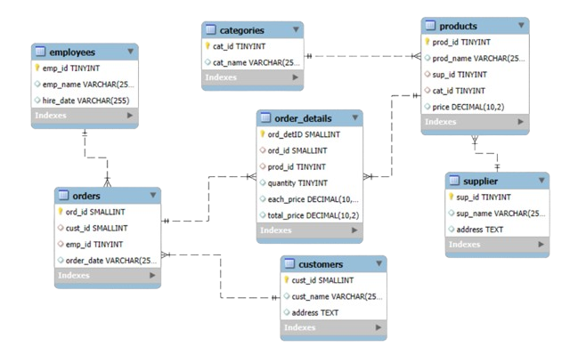

ER Diagram

Slide 5
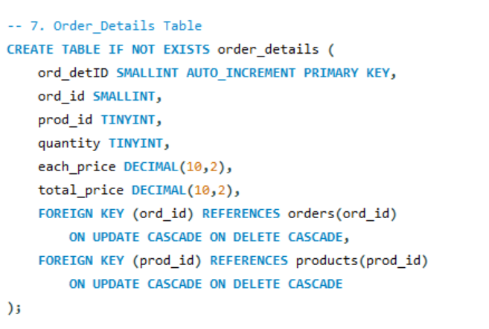
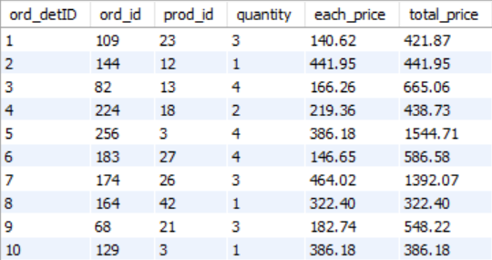
Schemas
order details table

Slide 6
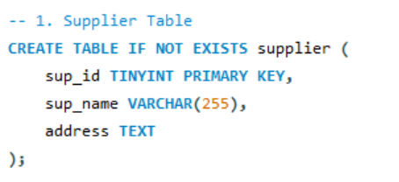
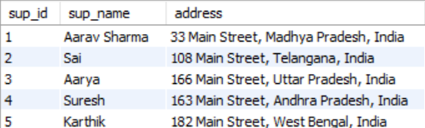
Schemas
2. Supplier table

Slide 7
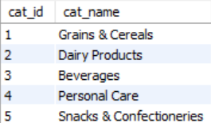
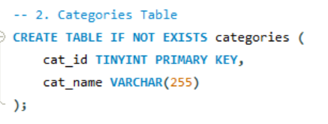
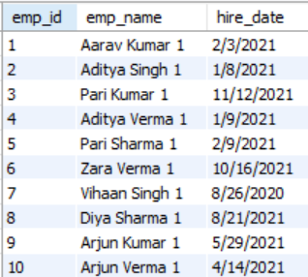
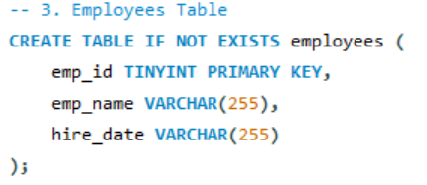
Schemas
3. Categories table
4. Employees table

Slide 8
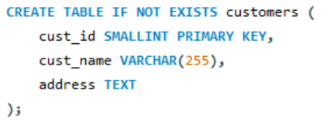
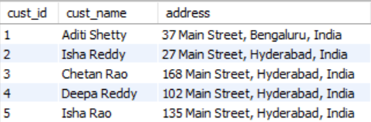
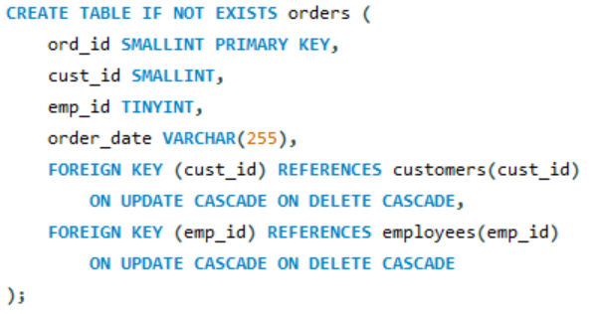
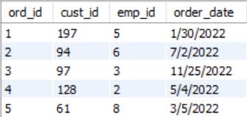
5. Customers table
6. orders table

Slide 9
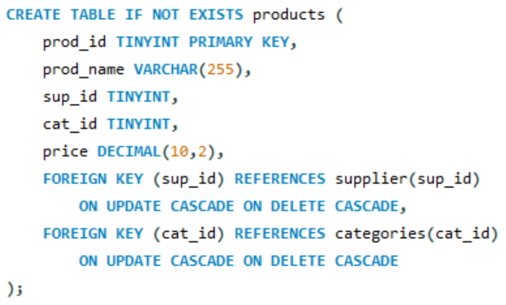
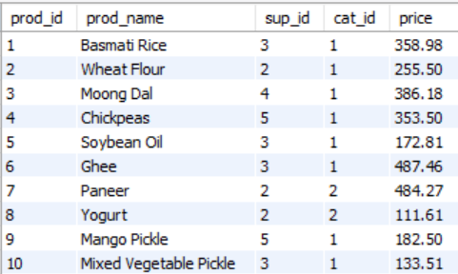
Schemas
7. Products table

Slide 10

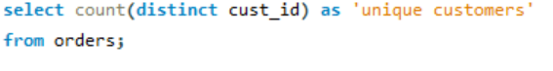
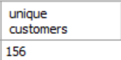

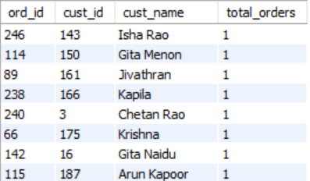
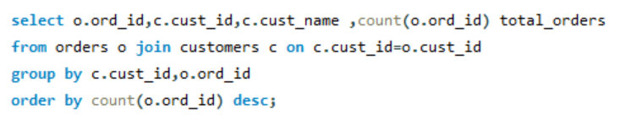

Analysis Questions
How many unique customers have placed orders?
2. Which customers have placed the highest number of orders?

Slide 11
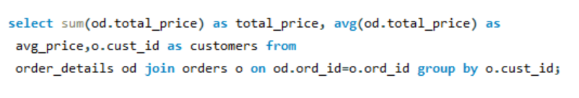

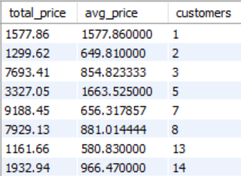
3. What is the total and average purchase value per customer?

Slide 12
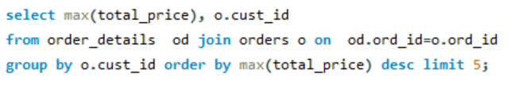
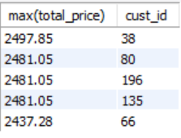


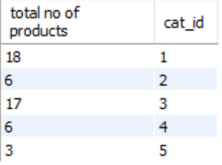
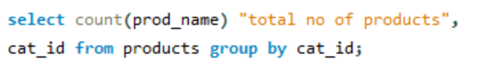
4. Who are the top 5 customers by total purchase amount?
5. How many products exist in each category?

Slide 13
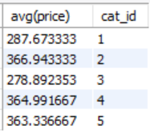


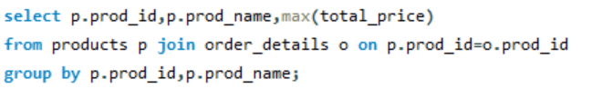
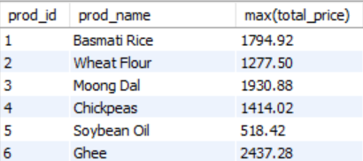
6. What is the average price of products by category?
7. Which products have the highest total sales (by quantity)?

Slide 14
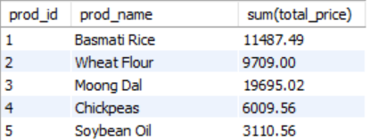
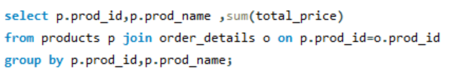
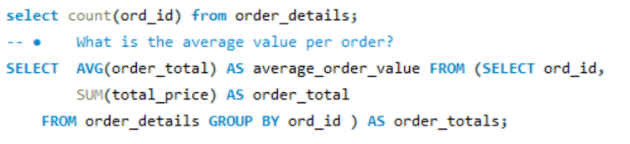
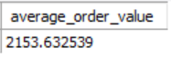

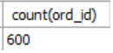
8. What is the total revenue generated by each product?
9. How many orders have been placed in total?
10. How many orders have been placed in total?

Slide 15
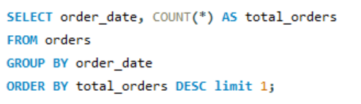
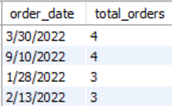

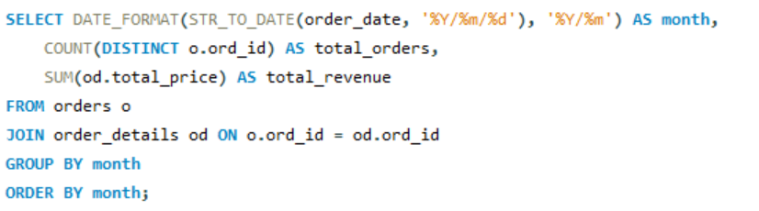
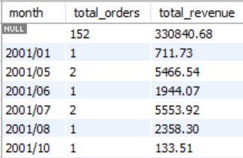
11. On which dates were the most orders placed?
12. What are the monthly trends in order volume and revenue?

Slide 16
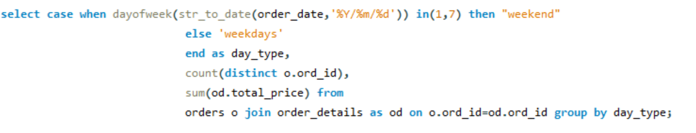
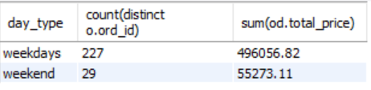

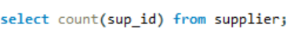
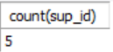
13. How do order patterns vary across weekdays and weekends?
14. How many suppliers are there in the database?

Slide 17
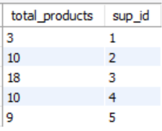
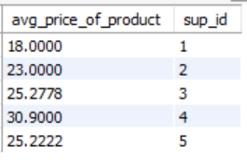
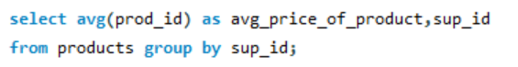
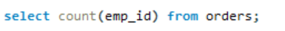
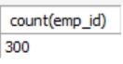

15. Which supplier provides the most products?
16. What is the average price of products from each supplier?
17. How many employees have processed orders?

Slide 18
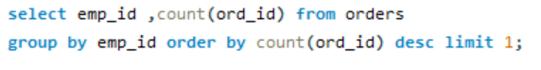
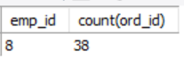

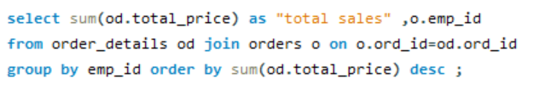
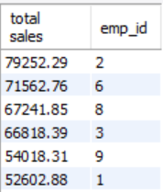
19. Which employees have handled the most orders?
20. What is the total sales value processed by each employee?

Slide 19




21. What is the average order value handled per employee?
22. What is the relationship between quantity ordered and total price?

Slide 20






23. What is the average order value handled per employee?
24. How does the unit price vary across products and orders?

Slide 21


Challenges
Understanding complex table relationships and applying correct types of joins..
Handling aggregation functions (e.g., SUM, AVG, COUNT) across multiple joined tables.
Extracting time-based trends from date data.
Maintaining scalability in the database design to accommodate future growth (e.g., more customers, products, employees).
Structuring queries that require grouping and filtering simultaneously (e.g., GROUP BY with HAVING clause).

Slide 22


Conclusion
By writing and executing a variety of SQL queries—including joins, aggregations, filtering, and subqueries—I was able to extract meaningful insights such as top-selling products, most valuable customers, and average order values per employee. The system not only ensures data consistency and integrity through the use of foreign keys and constraints but also supports scalability and future enhancements.

Slide 23


Insights Drawn from Query Analysis:
Top Customers: Identified high-value customers based on total purchase amounts, helping target loyalty programs or premium offers.
Best-Selling Products: Highlighted products with the highest sales volume, useful for inventory planning and promotional strategies.
Revenue Trends: Tracked order values over time to observe seasonal demand or monthly sales performance.
Employee Contributions: Analyzed average order values handled per employee to evaluate staff performance and efficiency.

Slide 24


THANK YOU

